Slide 1
Total Productive Maintenance (TPM) Playbook TEC-406-160019
August 2020
Global Operations

Slide 2




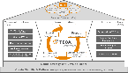
Using the TPM Playbook – What do the Icons Mean?
Where this Icon is visible refers to a point of information on the subject, linking to additional Playbooks or Training materials for example
Where this Icon is visible refers to a Tip / help
Where this Icon is visible refers to a special Note on the subject
Click on the House Icon to return to the TEOA House page
Click on the agenda icon to return to the agenda for the current phase
Return to Agenda

Slide 3


TEOA – Operations Management System
Key
PREMIER PARTNER FOR OUR CUSTOMERS
HIGHLY ENGAGED EMPLOYEES
Star Level Criteria
SUPERIOR RETURNS FOR OUR
SHAREHOLDERS
Transformational Tool
Balanced Scorecard (KPIs)
Operational Excellence (Lean)
Transformation
Technical Excellence
(COE)
Prepare
Diagnose & Design
Define Value & Design Future State
Implement
Create Flow & Pull
Sustain
Pursue Perfection
Strategy Alignment
Built in Quality ( Problem Solving MP, QCPC)
Opportunity to TE Best
Standard Work
Process Excellence Frameworks
Quick Changeover (EPEI)
Ready to Deploy Projects
Workplace Design (Cell Design & 3P)
Value Stream Management
(Material and Master Planning)
Technical Academies
Define Strategy and Develop Talent
Create Stability & Culture (EH&S, Quality Foundations, 5S& Visual Management, TPM, PIM)
Under Construction 31st July
Notes:
TPM is a Fundamental tool and is deployed site wide

Slide 4
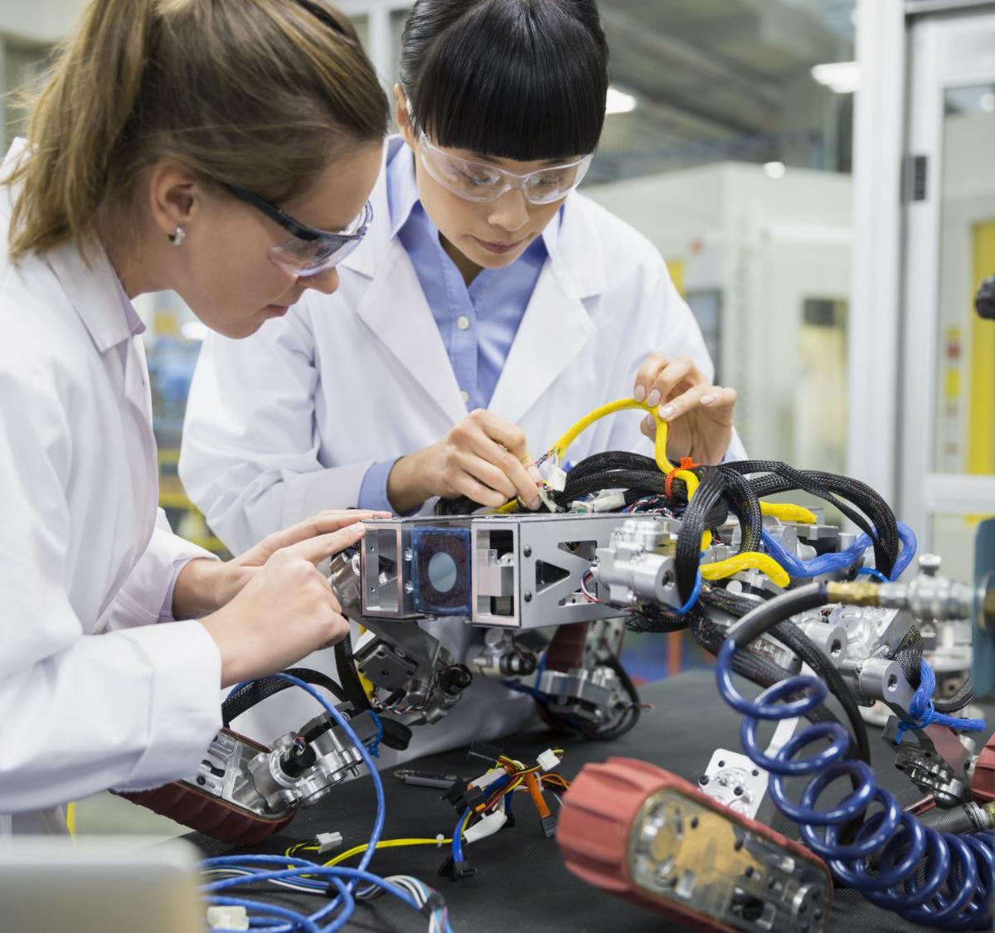
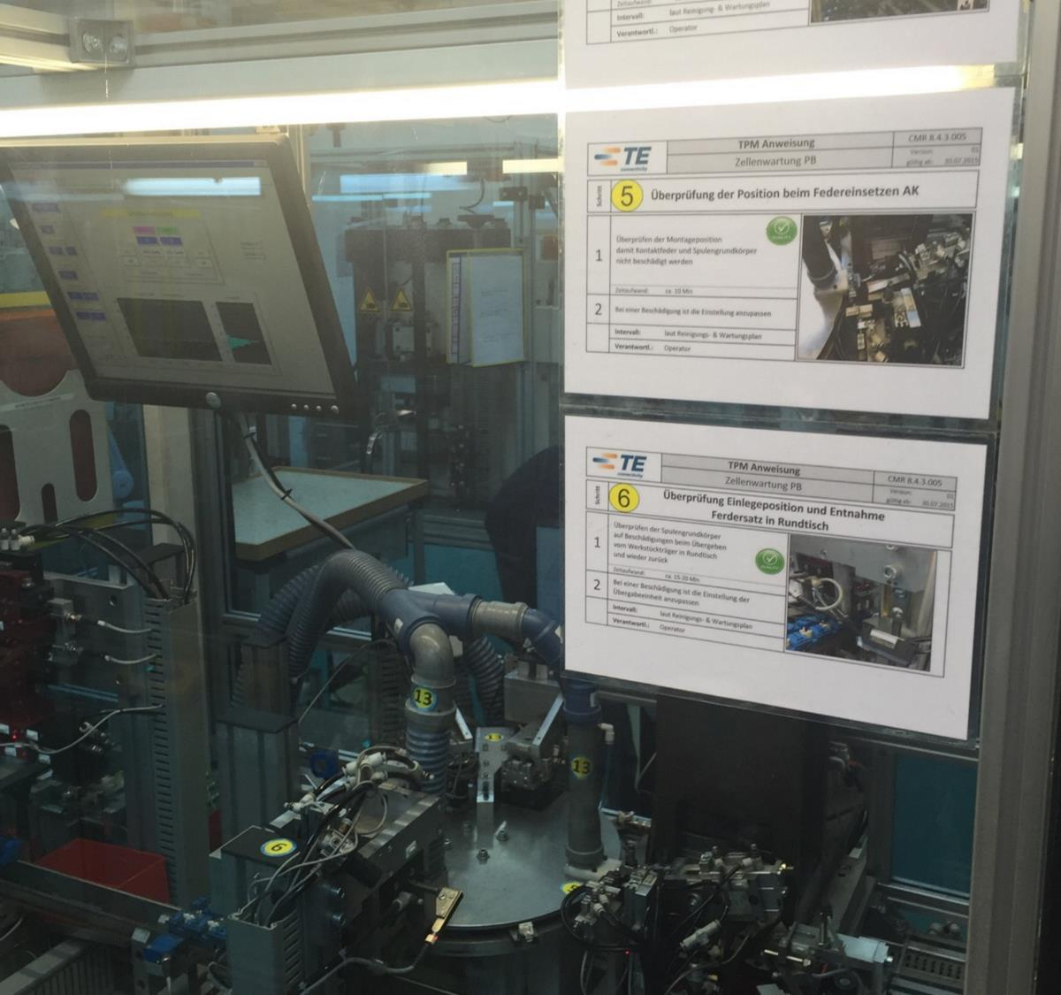
TPM
Total Productive Maintenance (TPM) restores equipment to ‘line-new’ condition and engages workers in continuous improvement efforts to reduce machine down time and ensure maximum machine availability

Slide 5
TPM Overview
Definition
What is the Purpose
Why Use it
How to Implement TPM
Best Practice Examples for TPM
BDP repository on TPM
TPM Diagnostic Questions
In this Playbook:
A definition of what is TPM
What is the Purpose of TPM
Why use TPM
How to implement TPM with training materials & best practices
Note: Click on the links above to quickly access the topic

Slide 6
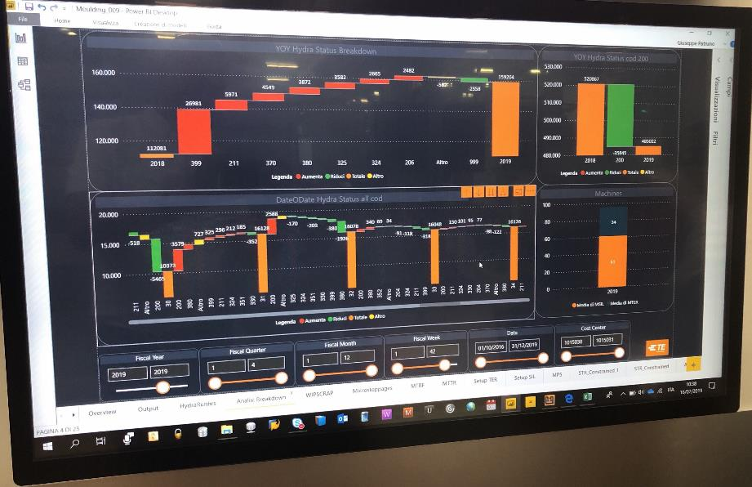
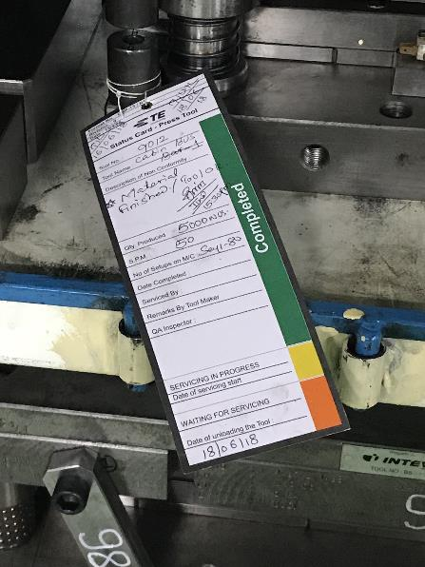
1. TPM Definition
Total Productive Maintenance (TPM) restores equipment to ‘line-new’ condition and engages workers in continuous improvement efforts to reduce machine down time and ensure maximum machine availability.
Return to Agenda

Slide 7
2. What is the Purpose of TPM
TPM is an approach to equipment maintenance that aims to:
Restore equipment to “like new” condition
Determine the appropriate maintenance strategy for equipment based on criticality (time based maintenance, preventative maintenance, predictive maintenance, condition based monitoring)
Maximize equipment effectiveness (speed, availability, utilization, quality)
involve production, engineering, quality and maintenance departments and all levels of the organization in maintenance activity
The TPM Process should be used on all equipment that impacts production. This includes actual production equipment (assembly machines, stamping presses, plating lines, etc.). It also includes building infrastructure equipment (air compressors, HVAC, critical electrical and water processing equipment).
Return to Agenda

Slide 8
2. What is the Purpose of TPM
Maintenance types:
Autonomous Maintenance:
“Independent” maintenance carried out by the operators of the machines or tools, rather than by dedicated maintenance technicians.
Corrective Maintenance:
Maintenance performed after a breakdown detection, always connected with correction and restart of production.
Purpose: Ensure the re-start of the equipment as soon as possible (even with degraded solutions)
Preventive Maintenance:
Maintenance performed according to predefined frequencies or criteria (number of cycles, risk caused by the breakdowns …)
Purpose: Reduce the probability of breakdowns or the wear out of the equipment.
Example: grinding, cleaning, replacement of spare parts.
Predictive maintenance (Condition Based Maintenance):
Maintenance based on the measurement of key parameters on the equipment
Example: vibration analysis on rotating machines, fluids analysis, thermography on electrical equipment, tool maintenance before start of Production Order (measurement of spare parts), check of pressure in the tool.
Return to Agenda

Slide 9
3. Why Use TPM
TPM has many positive outcome including the following:
Improve equipment performance and reliability.
Minimize equipment related losses in production operations.
Produce goods without reducing product quality.
Reduced emergency downtime.
Reduce total maintenance cost for equipment.
Produce low batch quantities at the earliest possible time.
Improve responsiveness to customer requirements.
Increased employee skill levels and knowledge.
Improve equipment life and reduce capital spend.
Return to Agenda

Slide 10
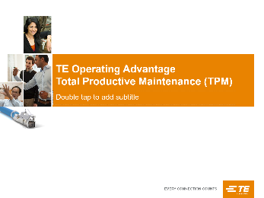
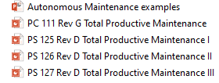


4. How to Use TPM
Prepare
Bring the concept of TPM to the employees through training TEOA 111 TPM
Share examples from within the plant plus best practices shared from other sites.
Form a TPM Steering Committee consisting of a multi-function group and assign a TPM Coordinator a dedicated resource.
Identify your critical equipment by using factors like: low OEE & high load; high consumption of spare parts; high unexpected downtimes; COPQ…
Establish Baseline Performance Metrics of your critical Equipment
OEE (training link to view training materials)
MTBF (Mean Time Between Failures)
MTTR (Mean Time To Repair)
Maintenance activities on time in %
Equipment Availability.(Tools, machines, facilities….)
Refer to training module TEOA 111 TPM
Additional and more detailed training materials available in TPM Folder on TEOA SharePoint
Return to Agenda

Slide 11
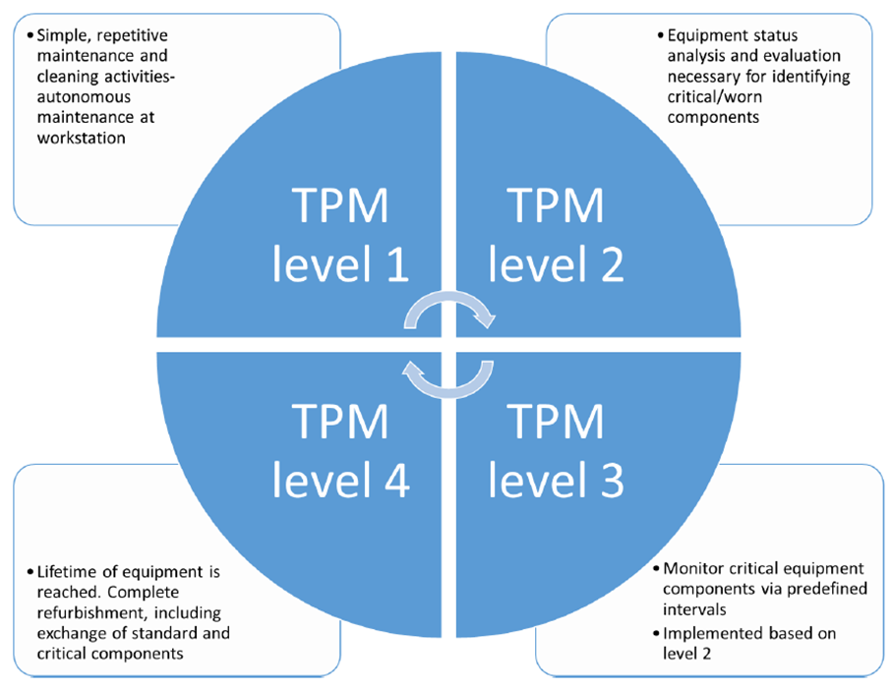
4. How to Use TPM
Diagnose and Design
Identify opportunities for improvement in areas with biggest gap on target expectations.
Consider the TPM level to target.
Assess potential benefits.
Compare similar equipment (Best vs. Worst) to have a first impression of potential improvements.
Collect Improvement actions, plan KAIZEN Events accordingly.
Prioritize and schedule TPM activities to the top contributing areas.
Use the Successfully Demonstrated Practice repository as input for solution finding and ready to deploy projects.
For additional information refer to the RTD TPM Playbook from the Technical Excellence community available on TechNet
Return to Agenda

Slide 12
4. How to Use TPM
Implement
A regular cadence of review is established to provide progress updates to the deployment Plan (Site-level min. monthly; Equipment-level min. weekly)
This should be led by the TPM Coordinator and should be attended by
Plant Manager
TEOA Site Leader
The Kaizen owners
Technical Excellence (as required)
The deployment plan is updated.
Clear actions identified for items which are Off track.
Green / Red coding is used to identify OnTrack / Off track.
Top management support
1
Monitor and use OEE
Introduce a comprehensive measure to track machine availability losses and prioritize opportunities
2
Rely on autonomous
maintenance
Instill a sense of ownership
Make full use of worker knowledge
3
Streamline the repair process
Standardize the repair process and improve efficiency by eliminating waste
TPM
Competitiveness
4
Deploy preventive
maintenance
Prioritize planned maintenance
Preserve specialist skills for complex tasks
worker involvement
5
Build capabilities
Technical training
Problem solving and teamwork training
Refer to the TEC-407-707 for more details on implementing TPM at your site
Return to Agenda

Slide 13

4. How to Use TPM
Sustain:
Check effectiveness of actions and if the expected return is being achieved.
PIM will continue to serve as the management mechanism to continuously improve the process and ensure the processes are running as designed supported by Visual Controls
Communicate successes with the employees for increased awareness.
Continue with training and education to increase TPM Skill levels on site.
Return to Agenda
This Photo by Unknown Author is licensed under CC BY-SA

Slide 14
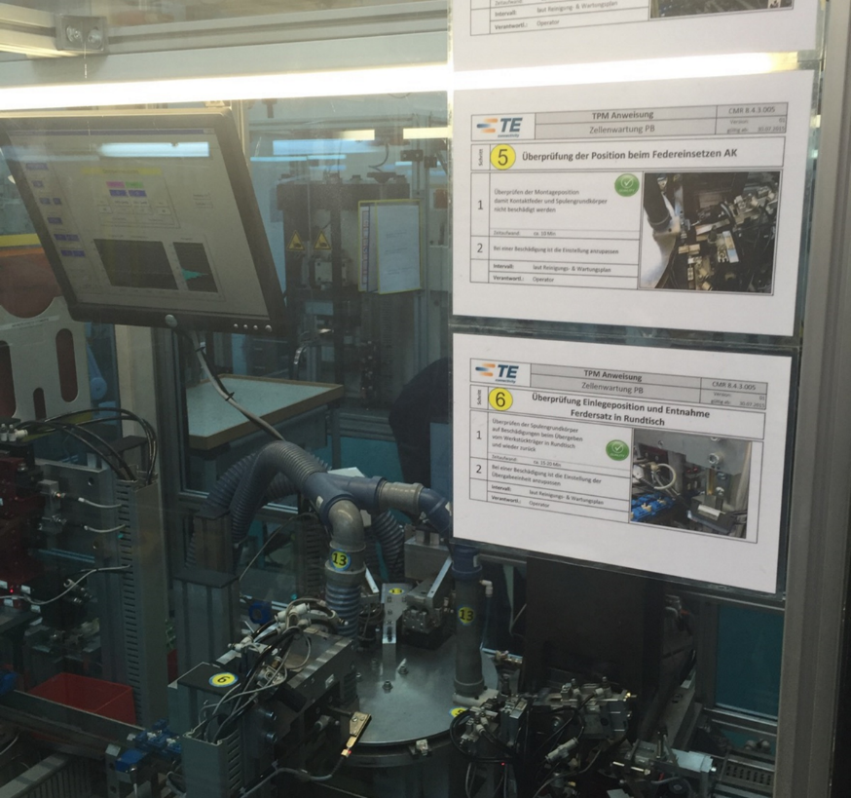
5. TPM Best Practice Examples – Autonomous Maintenance example
Number on machine matches to a number on the Standard work which explains to the worker what tasks need to be performed & when at this specific location
Return to Agenda

Slide 15
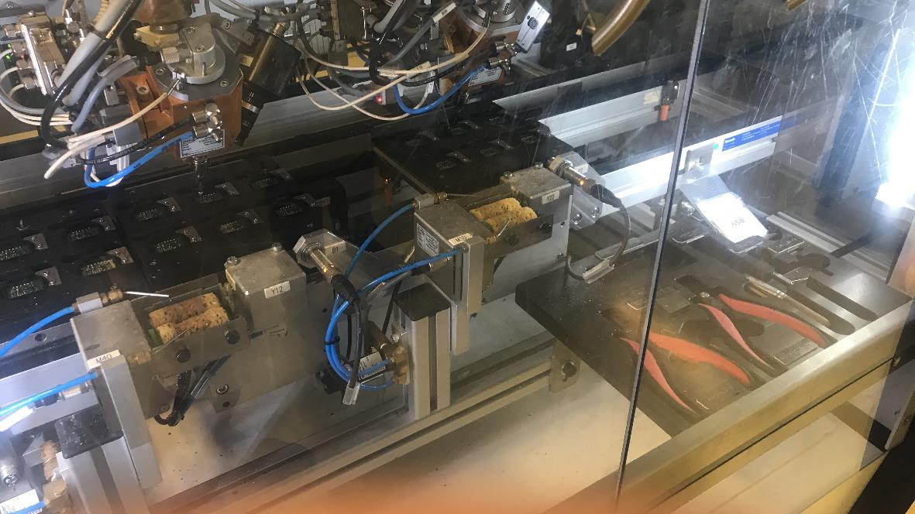
5. TPM Best Practice Examples – Autonomous Maintenance example
Tools necessary for maintenance are located in a safe location in the machine, ensuring they are always available to the operator when required, reducing downtime & improving repair time
Return to Agenda

Slide 16
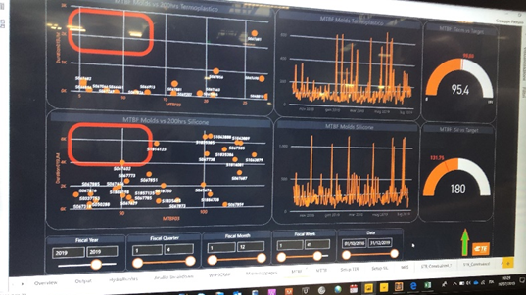
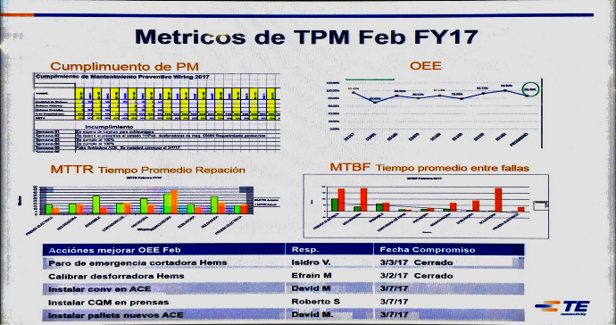
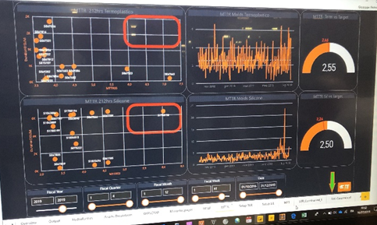
5. TPM KPI Metrics Tracking
MTBF Digital Tracking using PowerBi
Example of Manual posting of Metrics
MTTR Digital Tracking using PowerBi
Return to Agenda

Slide 17
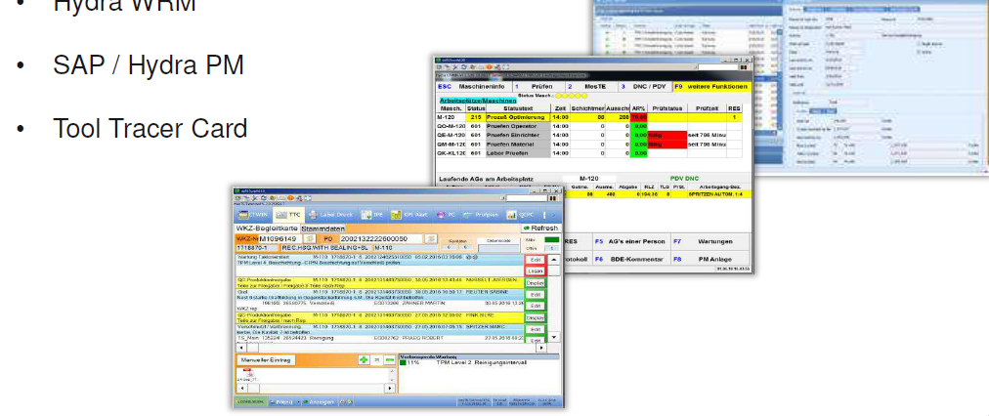
5. TPM Best Practice Examples – Digital example
Return to Agenda

Slide 18
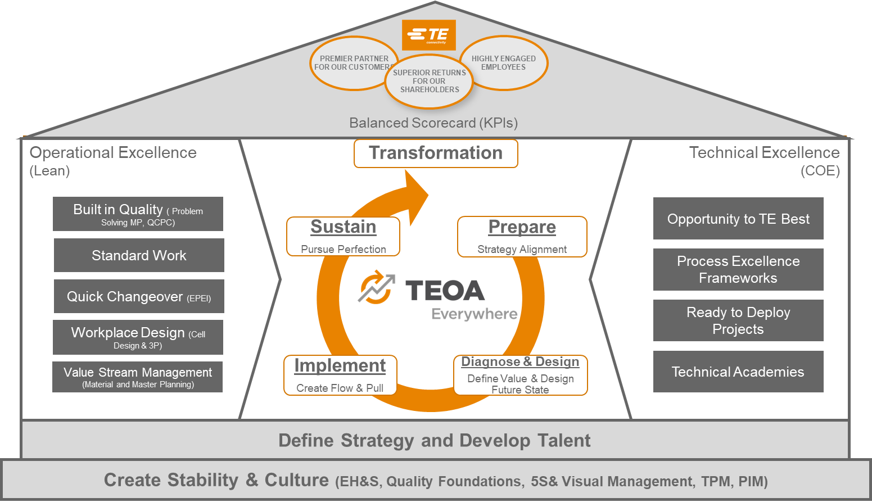
6. Access to Shared Best Practices
Click here to search for TPM SDPs
Return to Agenda

Slide 19

TPM - Improvement Over time
Prepare
Diagnose & Design
Implement
Sustain
The cycles surrounding TPM continue to mature as the site evolves over time.
See Diagnostic Questions on next page to help understand the sites level
Prepare
Diagnose & Design
Implement
Sustain
Cycles of Improvement
Prepare
Diagnose & Design
Implement
Sustain
Site TPM Path
Note
There that is no formal Assessment for this tool at Star level 3,4 or 5, however the expectation is for the cycles of Improvement to continue as the site matures.
Prepare
Diagnose & Design
Implement
Sustain
Stabilised
Prepare
Diagnose & Design
Implement
Sustain
Beginning
Time
Return to Agenda

Slide 20
Questions to Consider around TPM Deployment
Beginning
Have Site leadership teams completed training?
Have all employees completed Shop Floor (SF 101 & 102) training to have an understanding of TPM
Has a Site implementation team been established. Is this led by a key manager (TPM coordinator ) at the site with responsibility for maintenance?
Has a review of current maintenance practices including an audit of the completion performance of current PM been conducted?
Is there a site TPM implementation plan developed?
Have Metrics to track reduction in machine breakdowns been established?
Stabilised
Has constrained and / or critical equipment been identified?
Is there a systematic process in place where OEE is measured and improved for constrained or critical equipment?
Are scheduled Preventive Maintenance actions completed on time according to the maintenance plan? If not are there corrective actions?
Are key TPM Metrics such as MTBF and MTTR demonstrating a clear improvement trends?
Is PIM serving as the management mechanism to continuously improve the process and ensure the processes are running as designed? Do the Visual Controls support?
Are Improvement actions collected and KAIZEN Events planned and executed accordingly?
Cycles of Improvement
The expectation is the cycles of improvements will continue as the site matures.
Return to Agenda

